Slide 1
VIRTUAL REALITY AND AUGMENTED REALITY
Let’s step out from our real world to explore the virtual world by taking a quick look at both the realities….

Slide 2
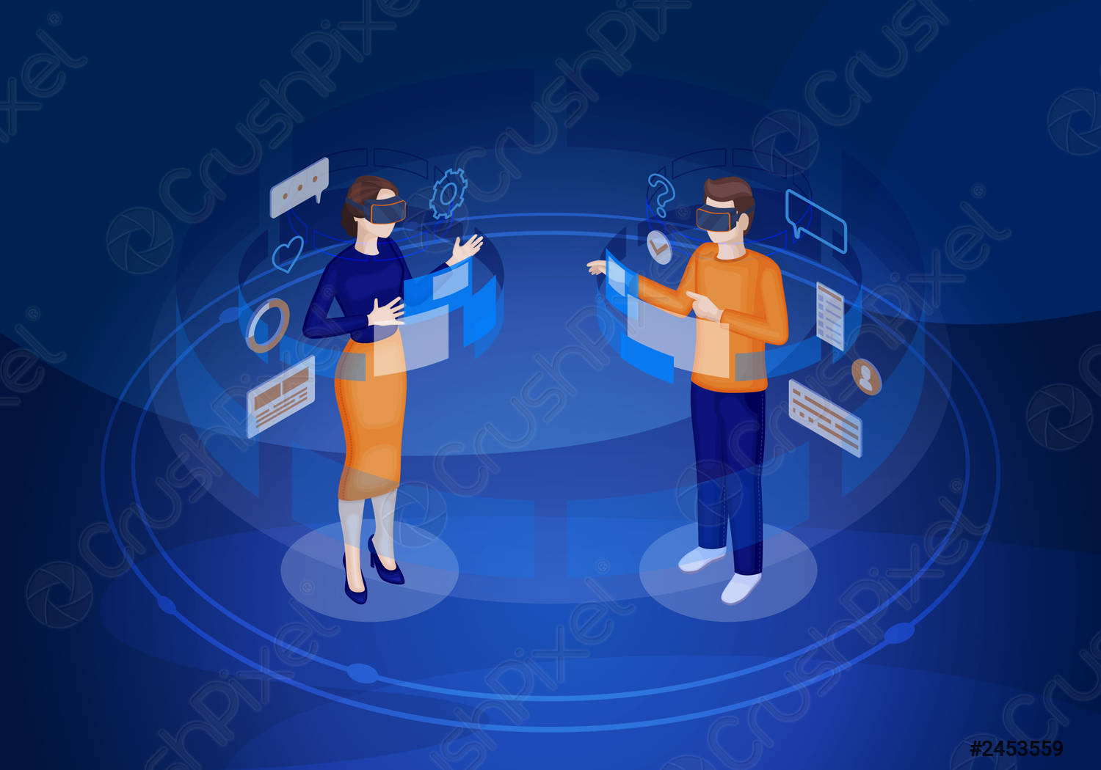
VIRTUAL REALITY
Virtual reality (VR) refers to a computer-generated simulation in which a person can interact within an artificial three-dimensional environment using electronic devices, such as special goggles with a screen or gloves fitted with sensors. In this simulated artificial environment, the user is able to have a realistic-feeling experience.

Slide 3
Some facts about virtual reality
Stanley Weinbaum, a reputed science fiction writer, depicted the virtual reality experience through goggles in the 1930s in his short story called Pygmalion’s Spectacles.
The first VR Headset came out in the 1960s. Coined as the Telesphere Mask by inventor Morton Heilig. This device features 3D TV capabilities, wide vision, and true stereo sound.
Jaron Lanier created a virtual reality device in the 1980s called the EyePhone 1/HRX that cost a whopping $49,000 for the goggles and gloves.
It was not until the 1990s that Virtual Reality was commercialized and became one of the biggest flops in tech history. Despite gathering public interest, devices were significantly overpriced and failed to deliver the quality assumed in the media hype.
Virtual I/O created a $1000 pair of virtual reality glasses called iGlasses in 1995.
The main concept of virtual reality is to create an artificial world that gives the exact feel of the real world in terms of vision. It is possible because a startup named Varjo is creating Bionic Display that gives you the exact feel that a human eye gives.
Some people say that Google Maps’ Streetview, which launched in 2007, was an early example of virtual reality.
Virtual Reality was considered dead for all practical purposes until, in 2012, a small scale developer Oculus VR initiated a Kickstarter campaign to raise $250,000 promising to develop a modern yet affordable VR headset called Oculus Rift.

Slide 4

AUGMENTED REALITY
Augmented reality (AR) is an interactive experience of a real-world environment where the objects that reside in the real world are enhanced by computer-generated perceptual information, sometimes across multiple sensory modalities, including visual, auditory, haptic, somatosensory and olfactory.

Slide 5
Some facts about augmented reality
1. Ivan Sutherland, a Harvard professor and computer scientist, created the first head-mounted display called ‘The Sword of Damocles’ in 1968.
2. Myron Kruger, a computer researcher and artist, built a laboratory at the University of Connecticut called ‘Videoplace’ that was entirely dedicated to artificial reality in 1974.
3. Tom Caudell, a Boeing researcher, coined the term ‘augmented reality’ in 1990.
4. Louis Rosenburg, a researcher in the USAF Armstrong's Research Lab, created ‘Virtual Fixtures’, which was one of the first fully functional augmented reality systems in 1994.
5. Julie Martin, a writer and producer, brought augmented reality to the entertainment industry for the first time with the theater production titled Dancing in Cyberspace in 1994.
6. Sportsvision broadcasts the first live NFL game with the virtual 1st & Ten graphic system – aka the yellow yard marker. The technology displays a yellow line overlayed on top of the feed to that views can quickly see where the team just advance to to get a first down in 1998.
7. NASA created a hybrid synthetic vision system of their X-38 spacecraft. The system leveraged AR technology to assist in providing better navigation during their test flights in 1999.

Slide 6
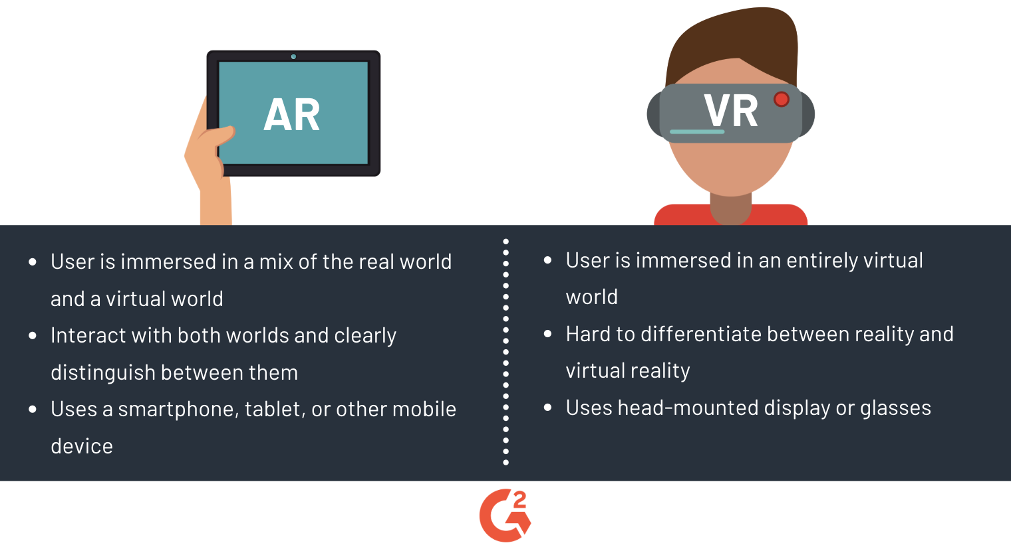
Ar-vr are not the same afterall .both are different and have their own distinct characteristics…… so let’s distinguish them….

Slide 7
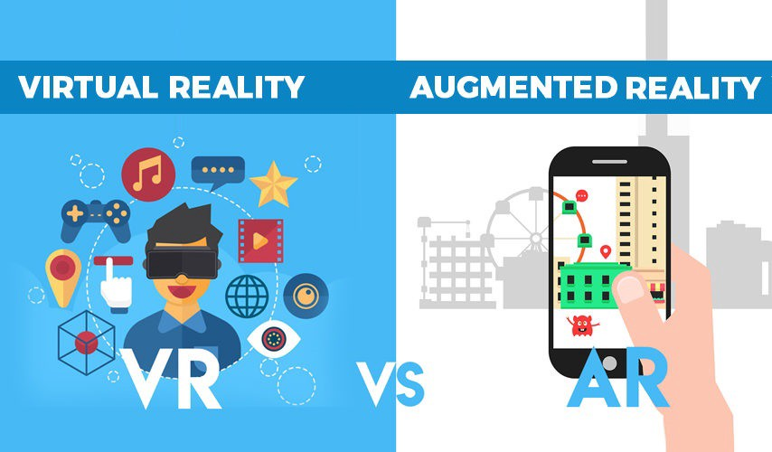
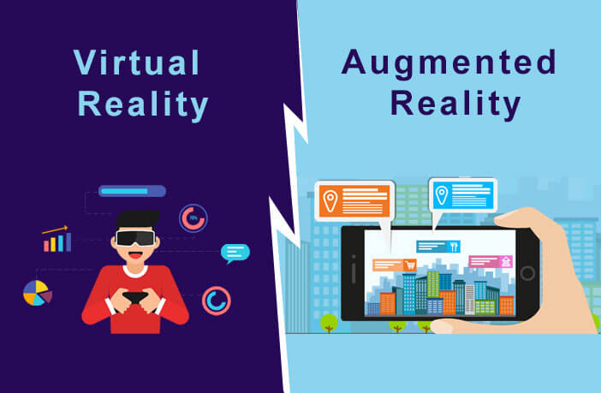
Both virtual and augmented realities are able to make a huge impact in our day to day lives in various aspects and slowly we are adapting it to our mundane uses so let’s have a quick look how they have impacted our lives….

Slide 8
Uses of virtual reality in today’s world
1: MILITARY
VR is used in all branches of service: the army, navy, air force, marines and coast guard. VR proves an effect method of training. The military uses it for flight simulations, battlefield simulations, medic training, vehicle simulation and virtual boot camp, among other things.
2: SPORTS
Virtual reality can be used by coaches and players to train more efficiently across a range of sports, as they are able to watch and experience certain situations repeatedly and can improve each time. Essentially, it’s used as a training aid to help measure athletic performance and analyse technique.
3: MEDICINE
Using VR technology in the medical industry is an effective way to not only improve the quality of students in training but it also presents a great opportunity to optimise costs, especially since health services are continuously under pressure with tight budgets.
4: EDUCATION
Students are able to interact with each other and within a three-dimensional environment. They can also be taken on virtual field trips, for example, to museums, taking tours of the solar system and going back in time to different eras. Virtual reality can be particularly beneficial for students with special needs, such as autism

Slide 9
Uses of augmented reality in today’s world
1:MEDICAL TRAINING
From operating MRI equipment to performing complex surgeries, AR tech holds the potential to boost the depth and effectiveness of medical training in many areas.
2:BUSINESS LOGISTICS
AR presents a variety of opportunities to increase efficiency and cost savings across many areas of business logistics. This includes transportation, warehousing, and route-optimization.
3:ENTERTAINMENT PURPOSES
Entertainment brands are now seeing AR as a great marketing opportunity to build deeper bonds between their characters and audience.
4:public safety
In the event of an emergency today, people will immediately reach for their smartphone to find out what's going on, where to go, and whether their loved ones are safe. Moreover, first responders arrive on the scene of a fire or earthquake trying to figure out who needs help, and the best way to get them to safety.

Slide 10
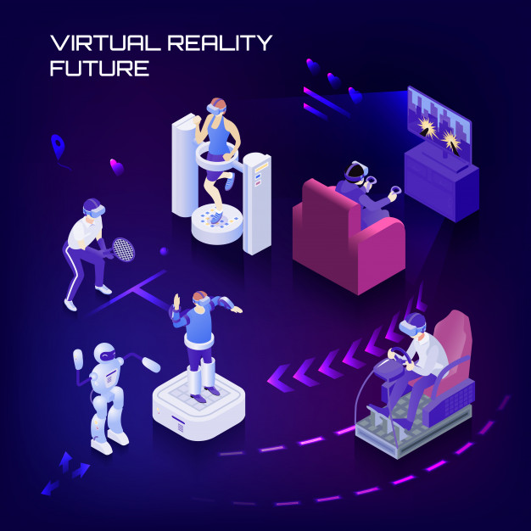
THE END I HOPE YOU GOT A ROUGH IDEA ABOUT AR-VR(THEIR USES AND DIFFERENCES)

